Slide 1
Image Classification with scikit-learn
Will Schnirring, Nathan O’Connor,
Ashhad Syed

Slide 2
Objective
Unsupervised clustering of a >1TB image set
Google’s Open Images v7
1TB subset of 20TB

Slide 3
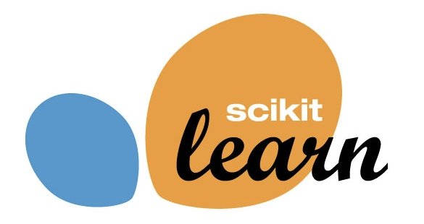
scikit-learn
Python
Popular, well-documented
Preprocessing
Feature extraction

Slide 4
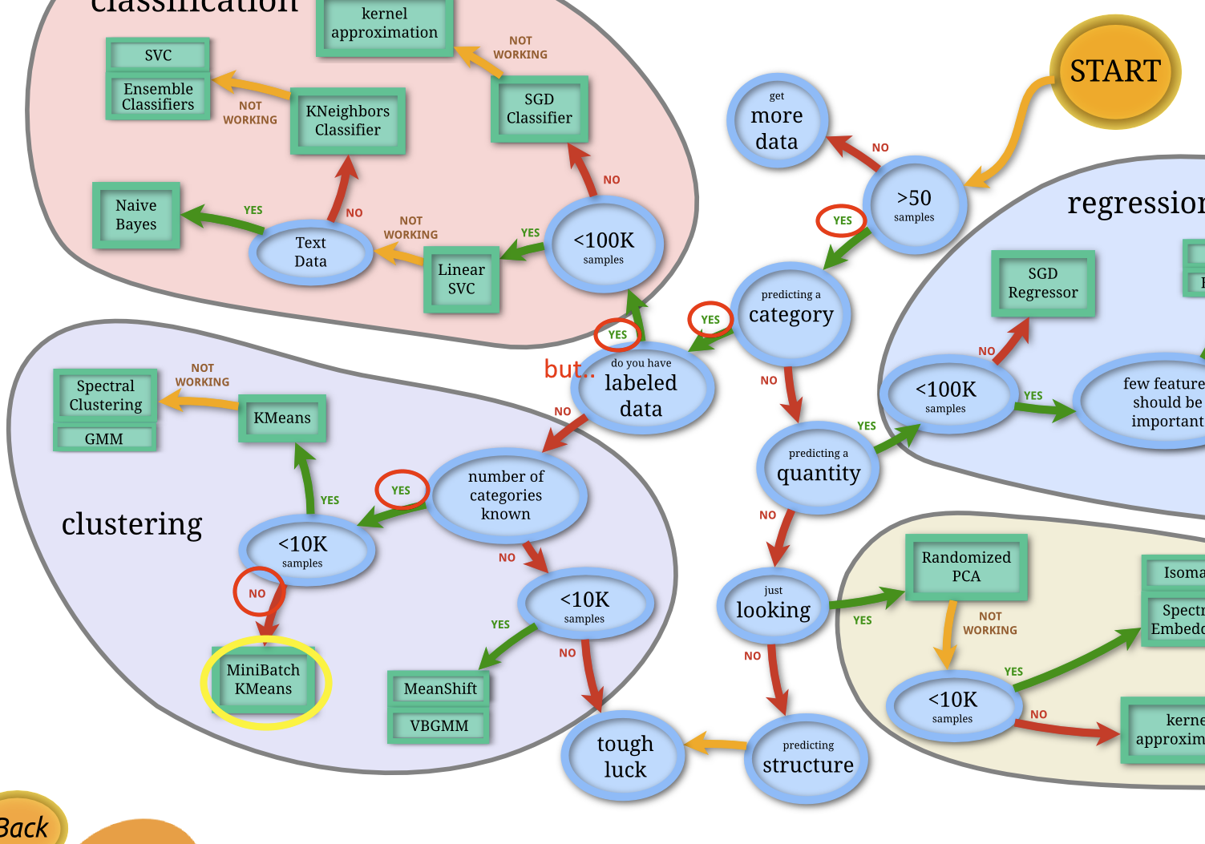
MiniBatch k-means
K-means clustering on subsets
Faster, comparable accuracy
partial_fit() method
Data size > system memory

Slide 5
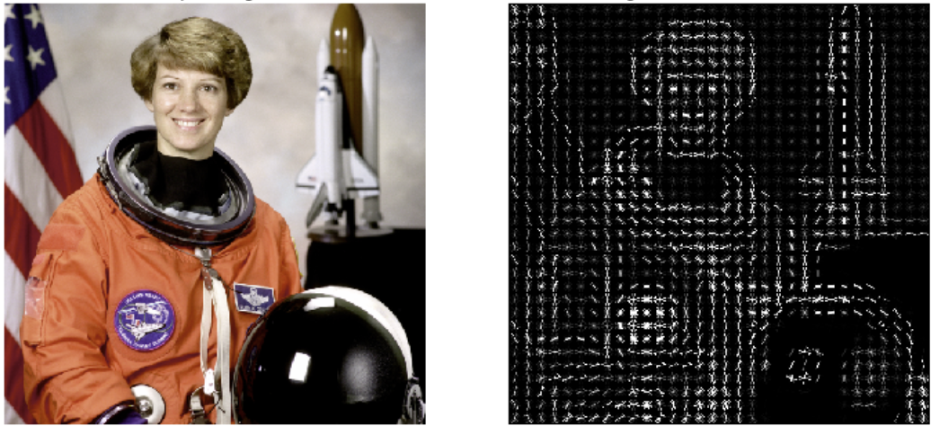
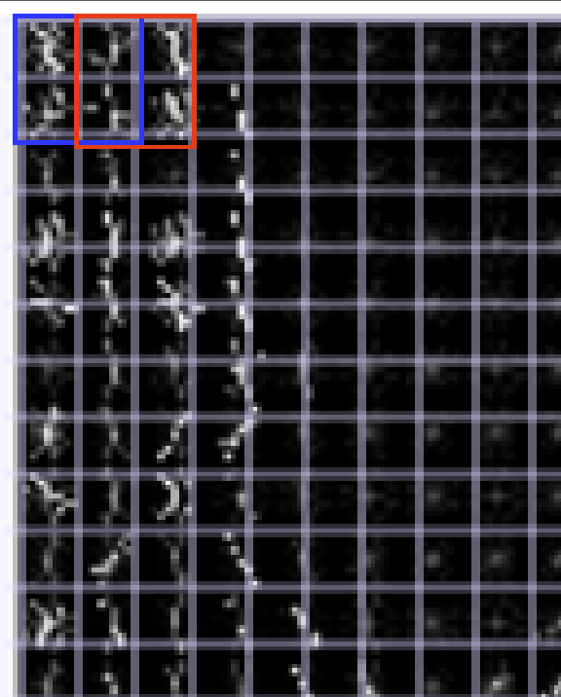
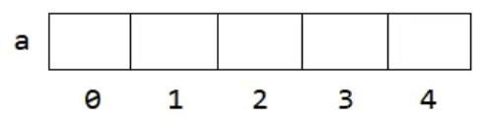
Image Processing
HOG - Histogram of Oriented Gradients
Greyscale
Resize
Transform
Block
Feature vector -> dataframe

Slide 6
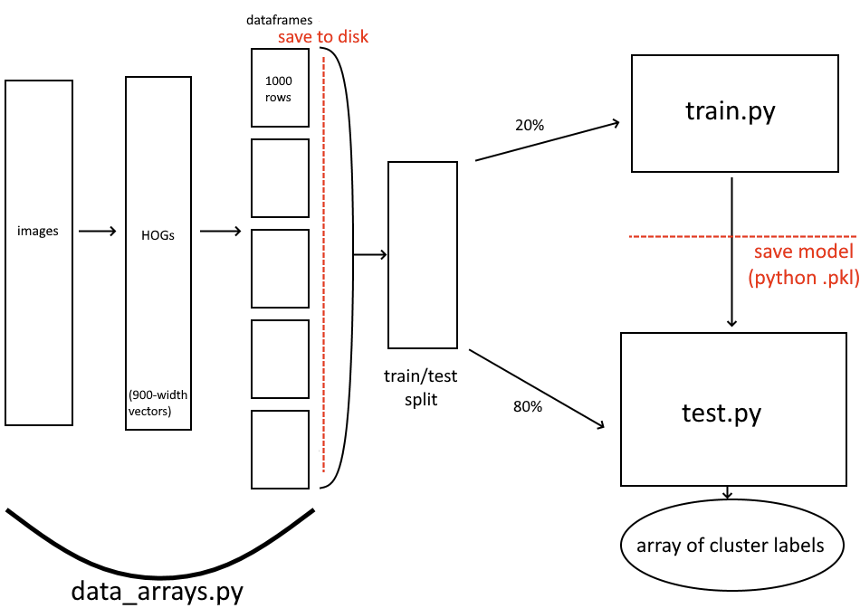
Design

Slide 7
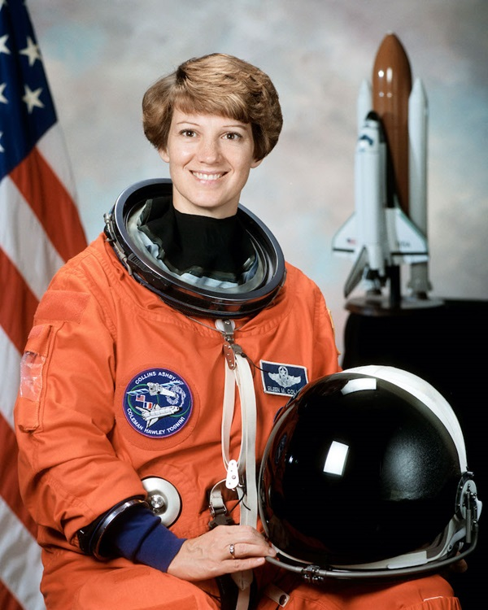
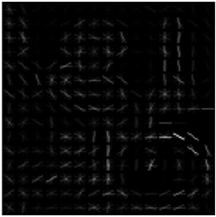
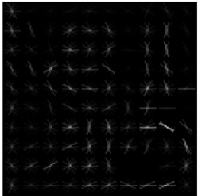
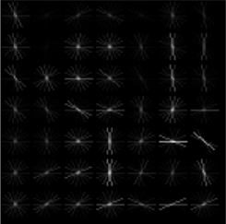
Implementation - Processing
Original
10x10, 2x2
Data_arrays.py
Walk bucket directory for images
Grayscale
Resize to 150x150
Create HOG
Pixels_per_cell: 21x21
Cells_per_block: 2x2
Feature vector Size: 900 features
Store feature vector into a dataframe in our bucket
15 x 15, 2 x 2
21 x 21, 2 x 2

Slide 8
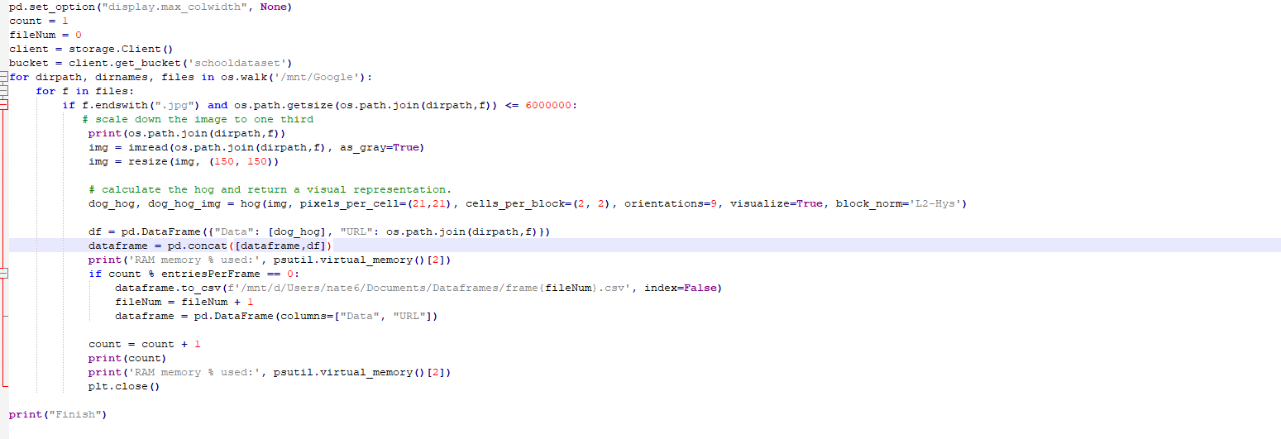
Data_array.py

Slide 9
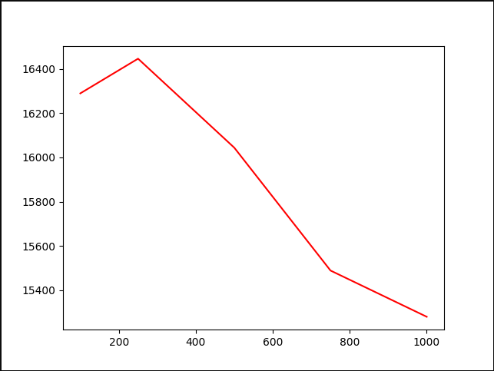
Implementation - Train/Test splitting
Train: 20% 154k images
Test: 80% 606k images
Batch size: 1k images
Cluster count: 1k

Slide 10
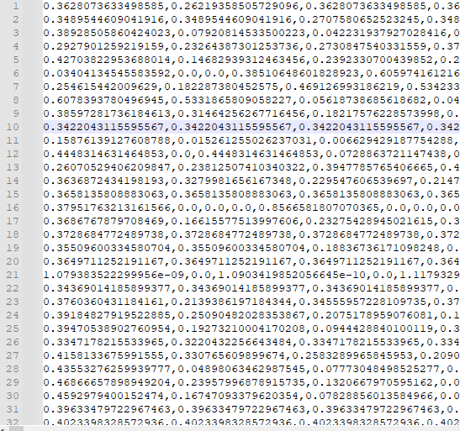
Implementation - Training
Train.py
Set random seed to
120983741920837410
Randomly select 20% of dataset
Walk through the bucket directory with feature vector dataframes
Load the dataframe and pass it to MiniBatchKmeans to train the model
Save index of images that weren’t used for training
Save the model

Slide 11
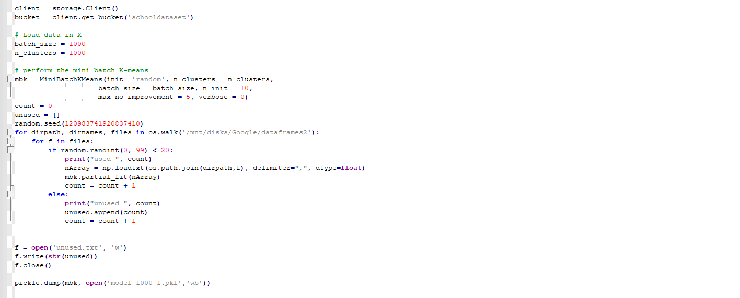
Train.py

Slide 12
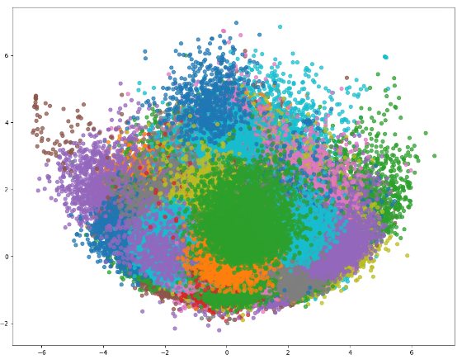
Implementation - Testing
Test.py
Load the model
Read feature vectors not used in training
Call MiniBatchKmeans.predict on feature vectors
Plot the unique labels that come from predict function

Slide 13
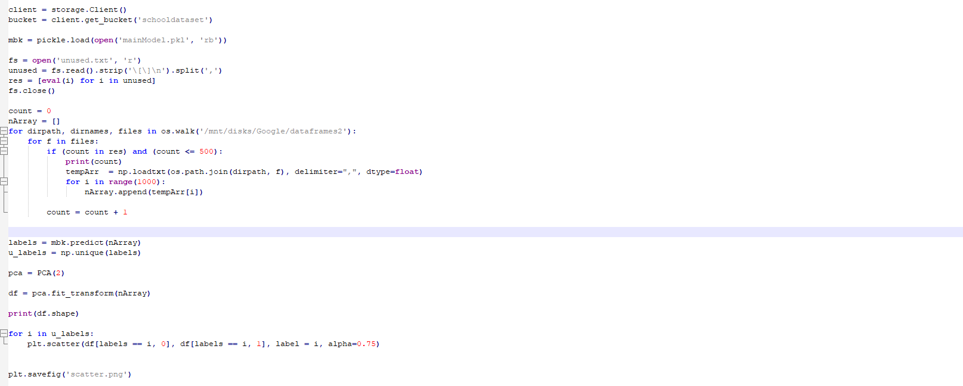
Test.py

Slide 14
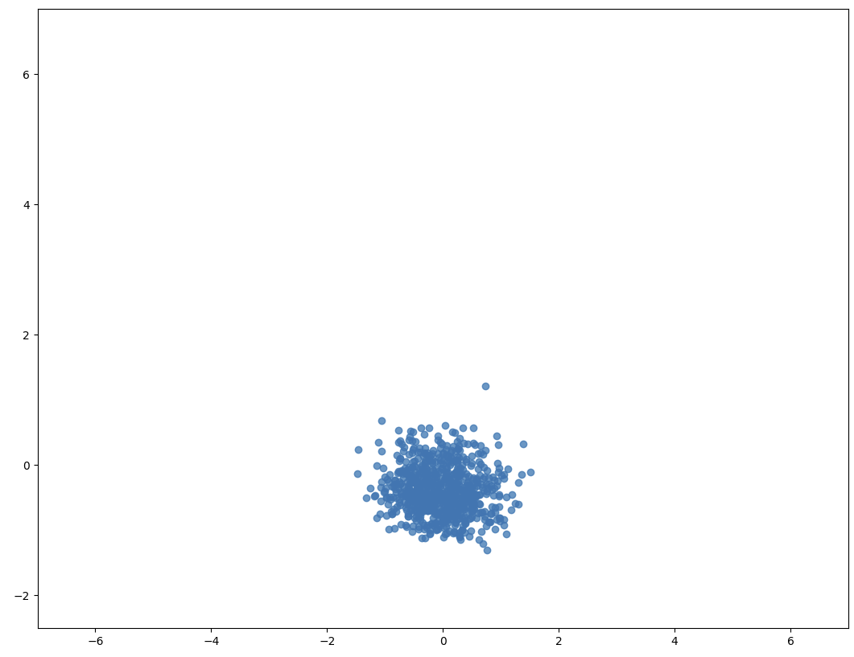
Results
Graphing one cluster

Slide 15
Improvements
Select images within a cluster
K-means with cluster n > 1000
Improve HOG resolution
PCA on larger feature count
Supervised learning: SGD, kernel approx.

